Slide 1
Wired Communication Standards
Kumar Yelamarthi
Central Michigan University
Mt Pleasant, MI
<number>

Slide 2
Motivation
Connect different systems together
    Two embedded systems
    A desktop and an embedded system
Connect different chips together in the same embedded system
    MCU to peripheral
    MCU to MCU
Without using a lot of I/O lines
    I/O lines require I/O pads which cost $$$ and size
    I/O lines require PCB area which costs $$$ and size
Options?
  Serial
  SPI
  I²C
<number>

Slide 3
Questions to ask in selection process
Number of wires required?
Asynchronous or synchronous?
How fast can it transfer data?
Can it support more than two endpoints?
Can it support more than one master?
How do we support flow control?
How does it handle errors/noise?
<number>

Slide 4
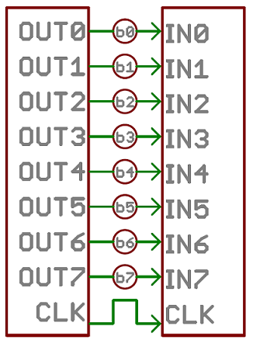
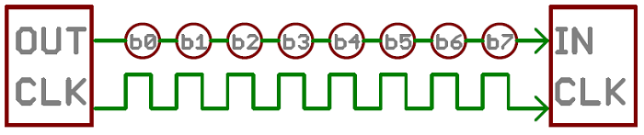
Parallel vs. Serial
Parallel
  Transfer multiple bits at the same time.
  Requires buses of data transmission wires (8, 16, 32,…)
  Fast, straightforward, relatively easy to implement
  Requires more input/output lines
Serial
  Transfer data one single bit at a time.
  Requires only two wires (data and clock)
  Relatively slow
Which is better suited for microcontrollers?
Source: Sparkfun
<number>

Slide 5
Synchronous and Asynchronous Serial
Known serial interface in embedded systems
  Universal Serial Bus (USB)
  Ethernet
  Serial standard
  SPI
  I²C
Synchronous Serial
  Pairs its data line with a clock signal, and all devices on serial bus share a common clock
  Faster serial transfer, but requires at least one extra wire between communicating devices
  Example: SPI, I²C
Asynchronous Serial
  Data is transferred without support from an external clock signal
  Ideal for minimizing the required wires and input-output pins.
  Examples: UART
<number>

Slide 6
Rules of Asynchronous Serial, aka Serial
Number of built-in rules help ensure robust and error free data transfer
  Baud rate
  Data bits
  Synchronization bits
  Parity bits
Baud rate
  Specifies how fast data is sent over a serial line.
  Usually expressed in units of bits-per-second (bps)
  Determines how long the transmitter holds a serial line high/low or at what period the receiving device samples its line
  Can be of any value, but both transmitter and receiver should have the same baud rate
  Standard baud rates are 1200, 2400, 4800, 9600, 19200, 38400, 57600, 115200
<number>

Slide 7
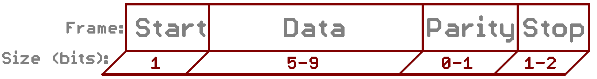
Data Packets in Serial transfer
Each block of data transmitted is actually sent in a packet/frame of bits.
Data bits
  Amount of data in each bit can be from 5 to 9 bits
  It is important to agree on endianness (is data sent MSB to LSB or vice-versa?)
  If order not stated, default is LSB sent first
Synchronization bits
  Two or three special bits are transferred along with data bits
  Start bit marks the beginning of a data packet. Usually 1 bit
    Indicated by an idle data line going from 1 to 0
  Stop bit(s) marks the end of a data packet. Configurable to 1 or 2 bit, usually 1 bit.
    Indicated by stop bit(s) transition back to the idle state by holding the line at 1.
Source: Sparkfun
<number>

Slide 8
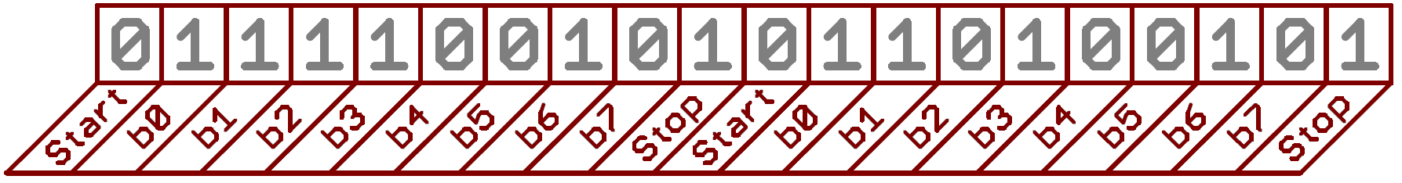
Data Packets in Serial transfer
Parity bits (Optional)
  A simple and low-level error checking method
  Options: Odd or Even parity
  Odd parity bit = 1 if the number of 1’s in data is odd
  Even parity bit = 1 if the number of 1’s in data is even
Example: 9600 8N1 OK
  Baud rate = 9600
  Data bits = 8
  Parity bits = No
  Stop bits = 1
  Data = OK
  O – ASCII Value = 79 = 01001111
  K – ASCII Value = 75 = 01001011
Source: Sparkfun
Source: Sparkfun
<number>

Slide 9
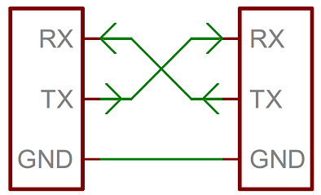
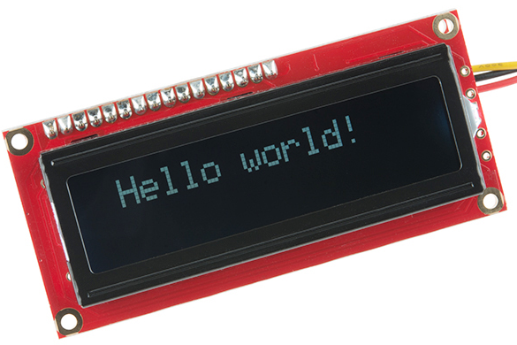
Serial – Wiring and Hardware
Serial bus consists of two wires
  TX – sends data
  RX – receives data
Interface can operate as full-duplex or half-duplex
  Full duplex – both devices can send and receive simultaneously
  Half duplex – devices must take turns sending and receiving
Some devices need only one way communication.
  Accordingly, only wire is visible
Source: Sparkfun
<number>

Slide 10
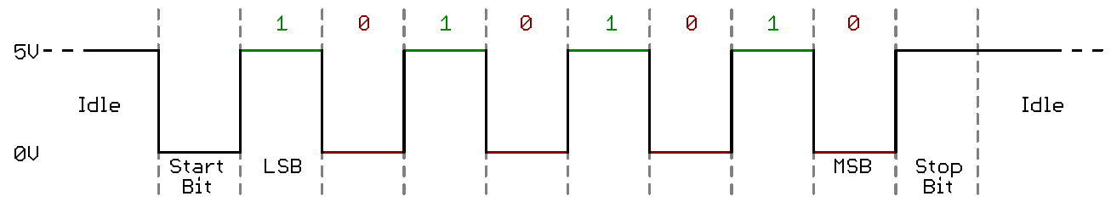
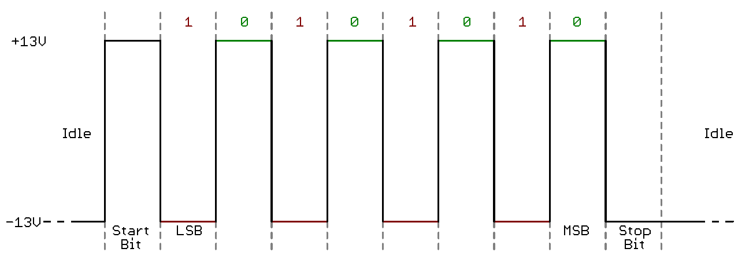
Serial – Hardware Implementation
Transistor-Transistor Logic (TTL)
  TTL serial signals exist between a microcontrollers’ voltage supply range (usually 0V to 3.3V or 5V)
  A signal at the VCC level indicates either an idle line, a bit of value 1, or a stop bit.
  A 0V (GND) signal represents either a start bit or a data bit of value 0.
  Easier to implement in embedded systems, but susceptible to losses across long transmission lines.
RS-232
  Usually found in old computers and legacy peripherals
  Usually range between -5V to +5V, though specs allow for anything from +/- 3V to +/- 25V.
  A low voltage indicates either the idle line, a stop bit, or a data bit of value 1.
  A high voltage indicates either a start bit, or a 0-value data bit.
  RS-485 is better suited to long range serial transmissions.
Source: Sparkfun
<number>

Slide 11
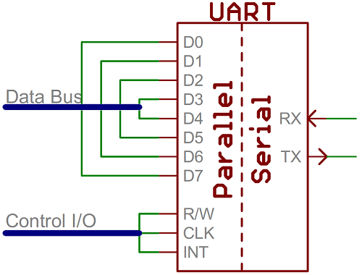
Universal Asynchronous Receiver/Transmitter - UART
UART is a block of circuitry responsible for implementing serial communication.
UART acts as an intermediary between parallel and serial interfaces.
Available as standalone ICs, but generally integrated inside a microcontroller.
On the transmit side, a UART must create the data packet and send it out with precise timing.
On the receive side, a UART has to sample RX lines, and extract the data from the packet received
Source: Sparkfun
<number>
Notes:
<number>

Slide 12
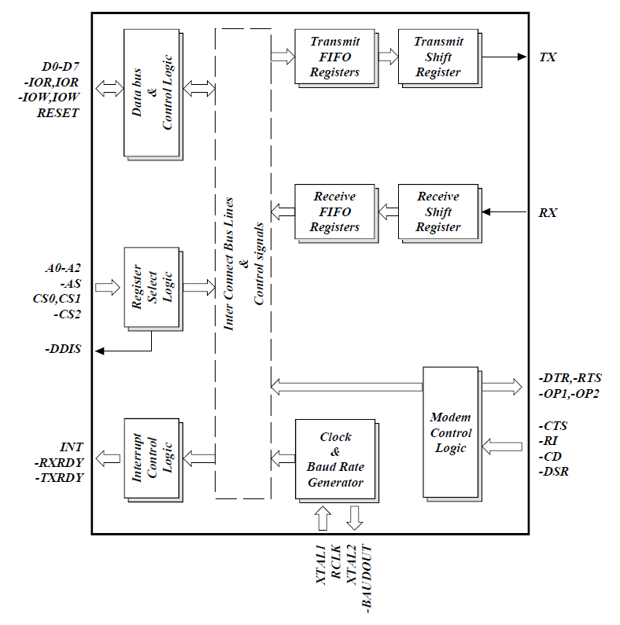
Universal Asynchronous Receiver/Transmitter - UART
Advanced UARTs have a built in buffer, where data is stored tentatively for the microcontroller to obtain when timely.
  Specifically useful in high speed data retrieval
Software UART
  Serial interface can be bit-banged, by the processor
  Not an ideal process, but works for simple applications
  Mostly common known as SoftwareSerial in Arduino
Source: Exar ST16C550
<number>

Slide 13
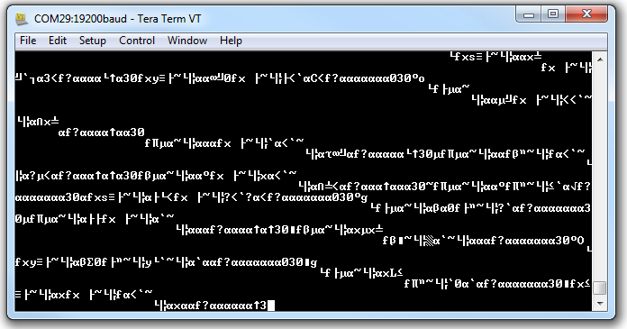
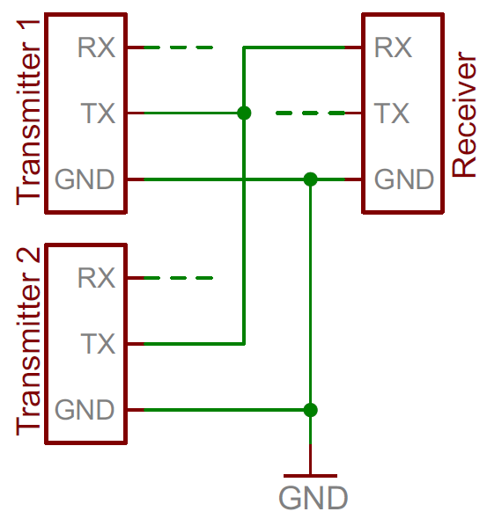
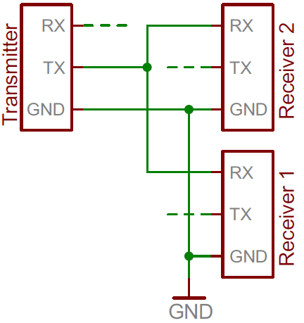
Common Mistakes in Serial Communication
Baud Rate Mismatch
  If two devices are not communicating at same speed, data can be misinterpreted or
  Make sure that baud rate is same on both devices
Bus Contention
  Serial communication is designed to allow just two devices to communicate across one serial bus.
<number>

Slide 14
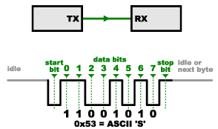
Limitations of Serial Communication
Lack of clock signal – no control over when data is sent or any guarantee that both sides are running at precisely the same rate.
This can be a problem when two systems with slightly different clocks try to communicate with each other.
Asynchronous serial connections add extra start and stop bits to each byte help the receiver sync up to data as it arrives.
Both sides must be at the same transmission speed.
Notice anything unusual with the data in the figure?
Serial protocols will often send the least significant bits first, so the smallest bit is on the far left.
  The lower nibble is actually 0011 = 0x3
  The upper nibble is 0101 = 0x5.
Source: Mike Grusin
<number>

Slide 15
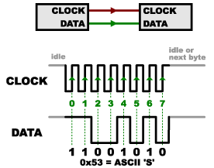

Serial Peripheral Interface (SPI)
SPI includes a clock signal and provides a synchronous solution
Uses separate lines for data and clock.
Clock signal keeps both devices in perfect sync.
Clock signal informs the receiver when to sample the bits on the data line.
When the receiver clock line detects the edge, it will look at the data line to read the next bit.
Advantage – a simple shift register can implement this function.
Limitation in current design?
Source: Mike Grusin
<number>

Slide 16
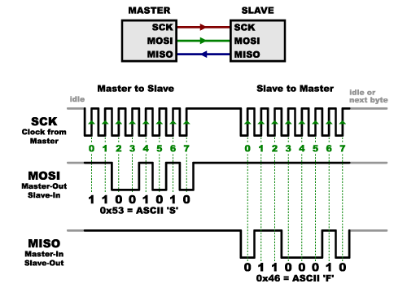
SPI – Receiving Data
Master – the side that generates the clock
Slave – the side that receives the clock
When data is sent from the master to a slave, it’s sent on a data line called MOSI -Master Out / Slave In
If the slave needs to respond, the master will continue to generate a prearranged number of clock cycles, and the slave will put the data onto MISO -Master In / Slave Out
Prearranged - Master must know in advance when a slave needs to return data and how much data will be returned
Full-duplex or half-duplex ?
Source: Mike Grusin
<number>

Slide 17
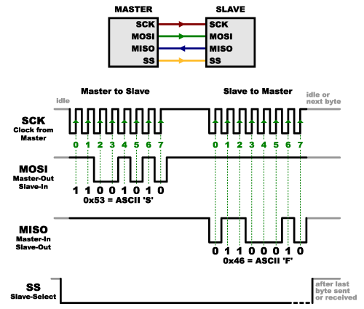
SPI – Slave Select
Slave Select informs the slave that is should wake up and receive/send data.
Useful when multiple slaves are present to identify the device of interest.
The SS line is normally held high, which disconnects the slave from the SPI bus.
Just before data is sent to the slave, the SS line is brought low, which activates the slave.
Source: Mike Grusin
<number>

Slide 18
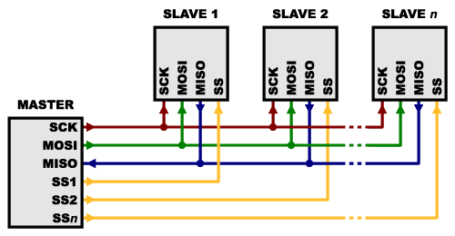
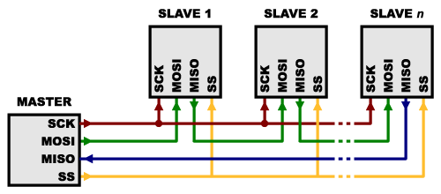
SPI – Multiple Slaves
Option-01
  Each slave will need a separate SS line
  Make the SS line of interest to low, and retain the other lines high
  Limitation – lots of slaves will require lots of SS lines
    Alternative: binary decoder chips
Option-02
  Daisy chain the MISO of one to MOSI of the other
  Limitation – data overflows from one slave to the next. You need to transmit enough data to reach all of the devices.
  First piece of data you transmit will end up in the last slave
Source: Mike Grusin
<number>

Slide 19
SPI - Summary
Advantages
Receiver hardware can be a simple shift register
Full duplex communication
Not limited to any maximum clock speed
Faster than asynchronous serial & high throughput
Supports multiple slaves
Disadvantages
It requires more signal lines
The communications must be well-defined in advance
The master must control all communications
Requires separate SS lines to each slave
No hardware slave acknowledgment
No error-checking protocol defined
Only handles short distances
<number>

Slide 20
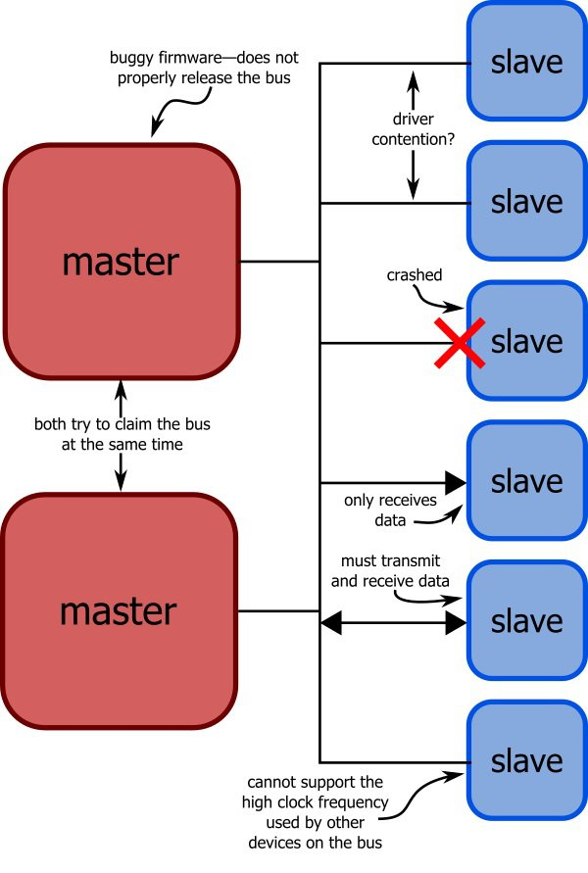
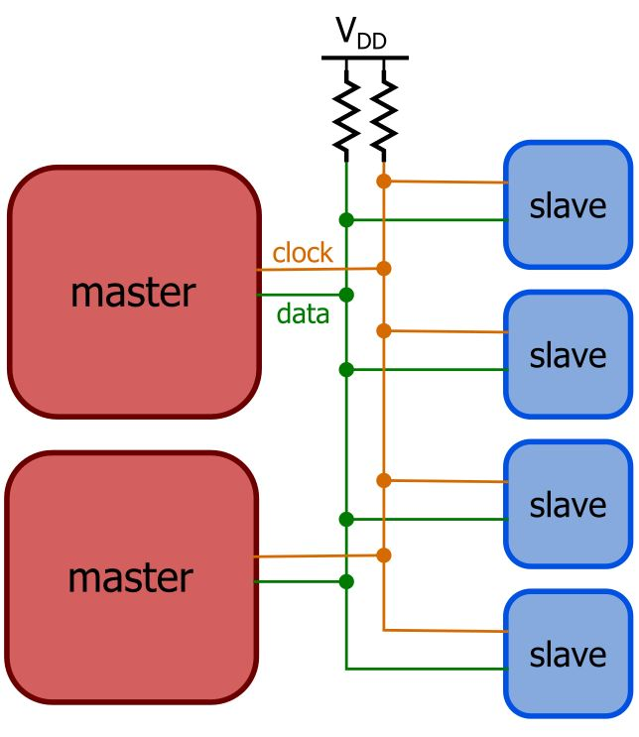
Challenges and Potential Solution
What if you have multiple slaves?
What if slaves does not know who the master is?
What if there are multiple masters?
What happens if a master requests data from a slave that for some reason has become nonfunctional?
What if the slave becomes nonfunctional in the middle of a transmission?
What if a master claims the bus to make a transmission then crashes before releasing the bus?
Source: All About Circuits
Source: All About Circuits
<number>
Notes:
http://www.allaboutcircuits.com/technical-articles/introduction-to-the-i2c-bus/
<number>

Slide 21
Inter-Integrated Circuit (I²C or I2C)
Only two signals (clock and data) are used, regardless of how many devices are on the bus.
Both signals are pulled up to a positive power supply voltage through pull-up resistors.
Each slave device is identified by means of a 7-bit address; the master must know these addresses of each slave.
All transmissions are initiated and terminated by a master.
The labels “master” and “slave” are inherently non-permanent: any device can function as a master or slave if it incorporates the necessary hardware and/or firmware.
Source: All About Circuits
<number>
Notes:
http://www.allaboutcircuits.com/technical-articles/introduction-to-the-i2c-bus/
<number>

Slide 22
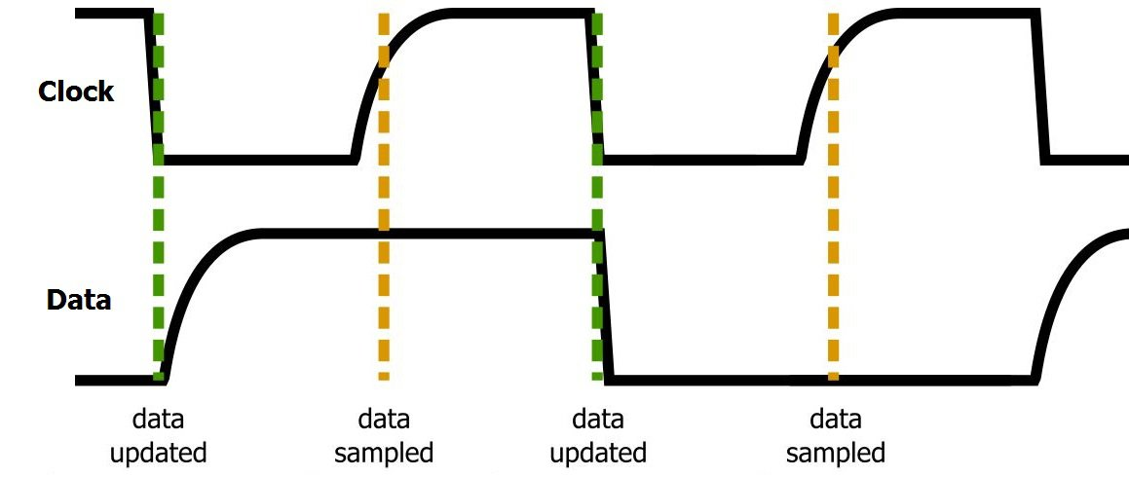
Inter-Integrated Circuit (I²C or I2C)
Data signal is updated on the falling edge of the clock signal and sampled on the rising edge.
Data is transferred in one-byte sections, with each byte followed by a one-bit handshaking signal referred to as the ACK/NACK (acknowledge or not-acknowledge) bit.
Source: All About Circuits
Source: All About Circuits
<number>
Notes:
http://www.allaboutcircuits.com/technical-articles/introduction-to-the-i2c-bus/
<number>

Slide 23
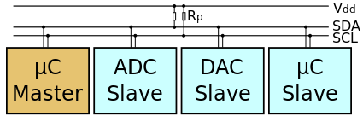
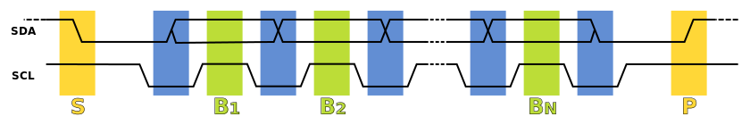
I²C Communications
Master initiates a start condition
Masters sends the 7-bit unique address of the device
Master outputs the read or write bit
Slave sends an acknowledge bit
Byte of data is exchanged followed by an acknowledgement
Transaction ends with the master device causing a stop condition
<number>
Notes:
<number>

Slide 24
I2C - Summary
Advantages
Maintains low pin/signal count even with numerous devices on the bus
Adapts to needs of different slave devices
Readily supports multiple masters
Incorporates ACK/NACK functionality for improved error handling
Disadvantages
Complexity of firmware or low-level hardware
Imposes protocol overhead and reduces throughput
Requires pull-up resistors
  Limit clock speed
  Consume valuable PCB real estate
  High power dissipation
<number>
Notes:
http://www.allaboutcircuits.com/technical-articles/introduction-to-the-i2c-bus/
<number>

Slide 25
SPI vs. I2C
http://www.byteparadigm.com/applications/introduction-to-i2c-and-spi-protocols/
Bus topology / routing / resources
Throughput / Speed
Elegance
<number>

